Slide 1
Innovation For Measure Energy Consumption
Abstract:
This paper proposes a comprehensive approach to measure energy consumption through modular implementation. The aim is to accurately monitor and analyze energy usage in diverse settings, enabling informed decision-making for improved sustainability. The proposed system comprises three key modules: (1) Data Acquisition Module, which gathers energy consumption data from various sources; (2) Data Processing and Analysis Module, responsible for processing the acquired data and generating meaningful insights; and (3) Visualization Module, designed to present the analyzed data in an intuitive and informative manner. The integration of these modules provides a robust framework for monitoring and managing energy consumption, ultimately contributing to a more sustainable and energy-efficient future.
Module 1: Data Acquisition
The first module focuses on acquiring energy consumption data from various sources, including smart meters, sensors, and IoT devices. It collects real- time data and historical records to provide a holistic view of energy consumption.
Module 2: Data Preprocessing
To ensure accurate analysis, the data is preprocessed in module 2. This involves cleaning, filtering, and normalizing data, as well as handling missing values. Data preprocessing ensures the reliability of subsequent analysis.
Module 3: Data Analysis and Visualization
Module 3 is responsible for conducting in-depth analysis of energy consumption patterns. It employs statistical methods and machine learning algorithms to identify trends, anomalies, and opportunities for optimization. Visualizations, such as graphs and charts, aid in conveying the insights.

Slide 2
Module 4: Energy Efficiency Recommendations
This module provides actionable recommendations based on the analysis from module 3. It suggests strategies to reduce energy consumption, improve efficiency, and lower costs. These recommendations can range from equipment upgrades to behavioral changes.
Module 5: User Interface and Reporting
A user-friendly interface is crucial for stakeholders to interact with the system. Module 5 offers a dashboard that displays real-time energy consumption data and reports generated by module 3 and 4. It enables users to monitor progress and make informed decisions.
Module 6: Integration and Scalability
The system is designed to be modular and easily integrated into existing infrastructure. It can scale to accommodate diverse energy sources and accommodate the evolving needs of different industries.
Module 7: Security and Compliance
Ensuring the security of energy consumption data is paramount. Module 7 addresses data protection, access control, and compliance with relevant regulations to safeguard sensitive information.
In conclusion, the proposed modular system provides a comprehensive solution for measuring and managing energy consumption. Its adaptable design allows it to be deployed in various domains, including residential, commercial, and industrial settings, contributing to sustainability and cost savings.

Slide 3
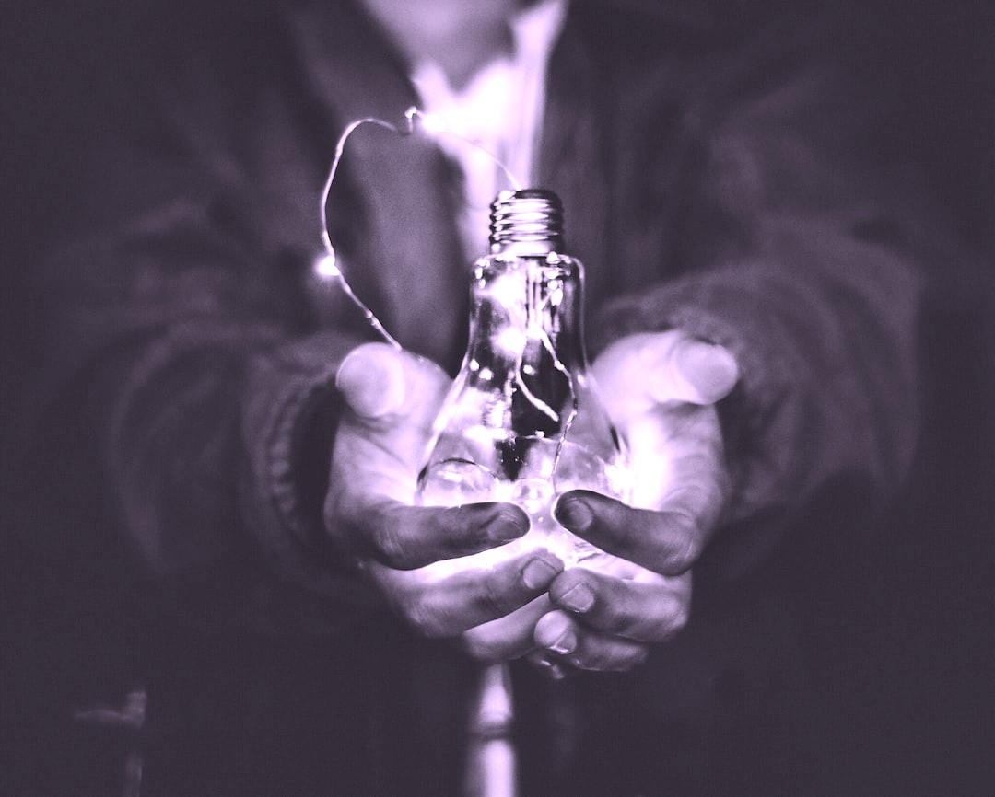
1. Introduction: Importance of measuring energy consumption accurately.
In a world increasingly focused on conserving energy, precise measurement of energy consumption is vital. By implementing
ef cient strategies to measure and monitor energy usage, businesses can uncover valuable insights and unleash the power of precision. With this newfound understanding, organizations can optimize energy usage, reduce costs, and make informed decisions for a sustainable future.

Slide 4
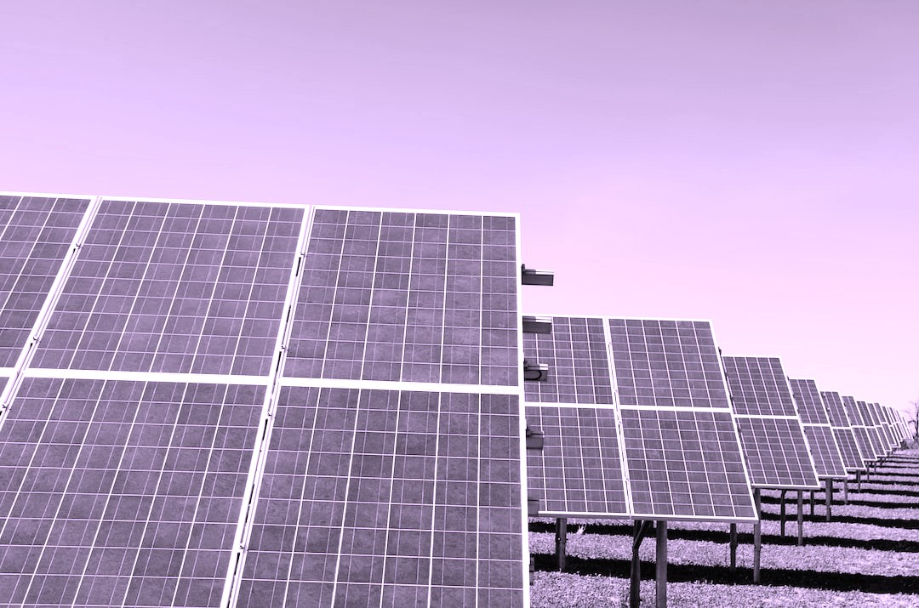
2. Understanding energy consumption metrics and their significance.
To effectively measure energy consumption, it is crucial to understand key metrics and their signi cance. Metrics such as
kilowatt-hours (kWh), peak demand, and power factor can provide insights into energy usage patterns, ef ciency levels, and potential areas for improvement. By analyzing these metrics, businesses can identify opportunities for energy optimization, cost reduction, and sustainable practices.

Slide 5
While measuring energy consumption, there are several challenges that need to be addressed. These include data accuracy, access to real-time information, and data integration from different sources.
Additionally, ensuring data security and privacy is essential to maintain trust and compliance. By overcoming these challenges, businesses can unlock the power of precision in energy measurement and make informed decisions for energy ef ciency and sustainability.
3. Key challenges in measuring energy consumption e‰ciently.

Slide 6
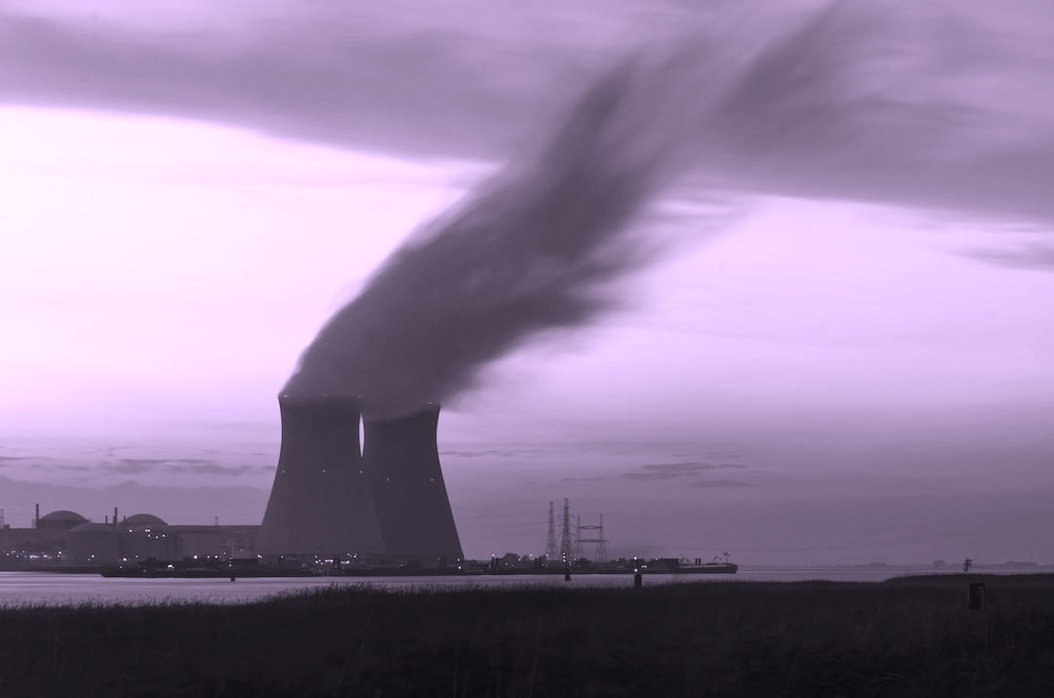
Advanced metering technologies offer accurate and real-time measurements of energy consumption, enabling businesses to identify inef ciencies and optimize energy usage. These technologies include smart meters, submetering systems, and energy management software. By leveraging these tools, businesses can gain valuable insights into their energy consumption patterns and implement targeted strategies for improved energy ef ciency and sustainability.
4. Section 1: Leveraging advanced metering technologies for precise measurements.

Slide 7
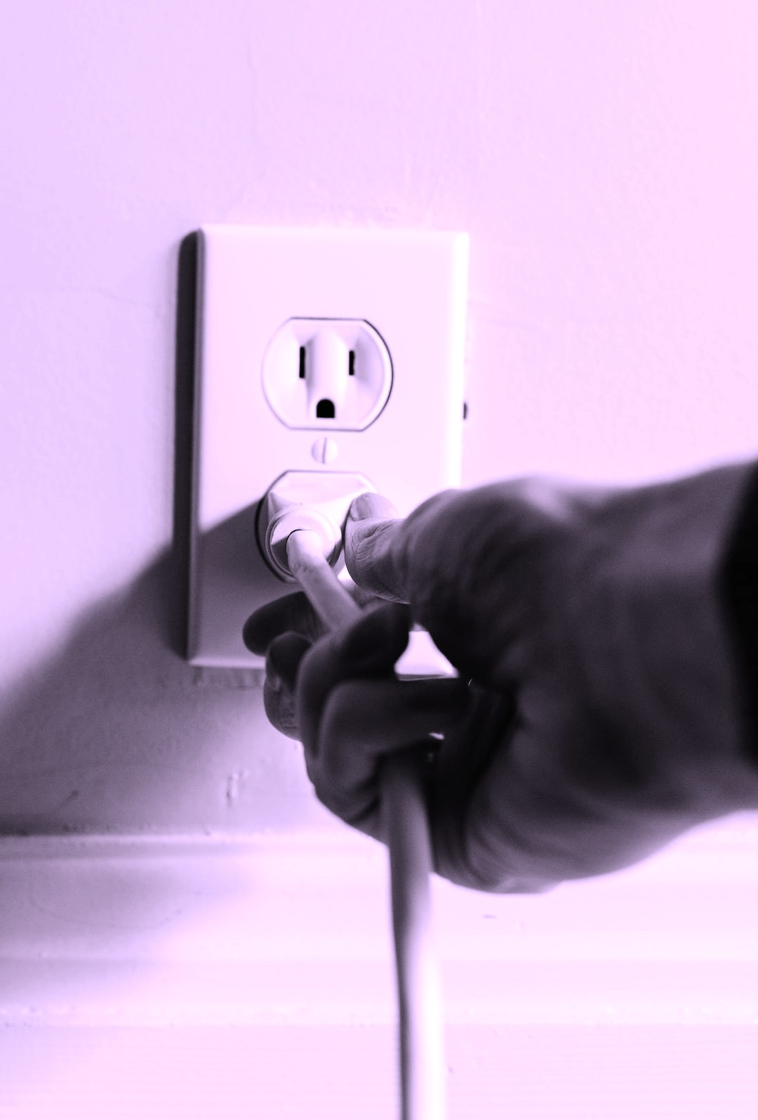
The Internet of Things (IoT) plays a crucial role in optimizing energy consumption monitoring. With IoT-enabled devices, businesses can gather granular data on energy consumption in real-time. This data can then be analyzed to identify
energy-saving opportunities, set benchmarks, and track progress towards sustainability goals. IoT also allows for remote monitoring and control, enabling businesses to make timely adjustments and optimize energy usage ef ciently.
5. The role of IoT in optimizing energy consumption monitoring.

Slide 8

6. Section 2: Implementing data analytics for detailed energy consumption insights.
To fully leverage the power of precision in energy consumption, data analytics is essential. By collecting and analyzing granular data from IoT-enabled devices, businesses can gain detailed insights into their energy consumption patterns. This information can identify areas of improvement, optimize energy usage, and monitor progress towards sustainability goals effectively. With data-driven decision-making, businesses can achieve greater ef ciency and cost savings in their energy management strategies.

Slide 9
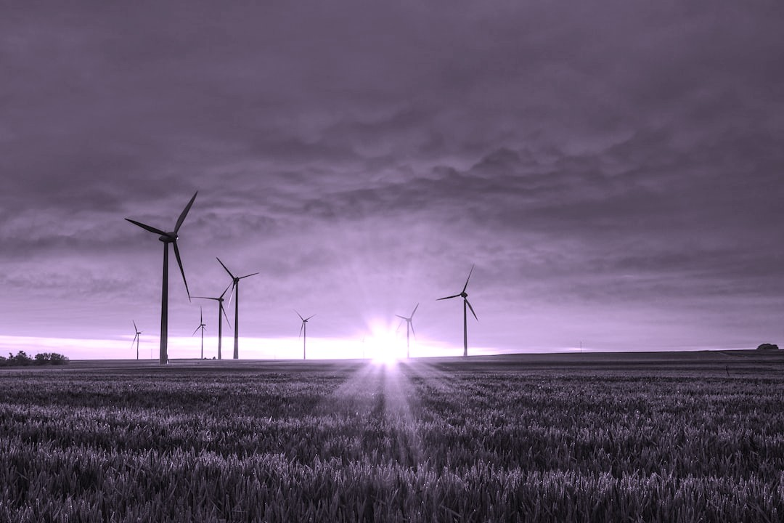
7. Case studies showcasing successful energy measurement strategies.
To understand the practical application of energy measurement strategies, let's explore a few case studies. These real-life examples will highlight successful implementations of precision energy consumption measurement techniques. We will delve into the challenges faced, the solutions implemented, and the positive outcomes achieved. These case studies will provide valuable insights and inspire businesses to adopt ef cient strategies for measuring energy consumption.

Slide 10
8. Section 3: Integrating energy monitoring tools with smart building systems.
Integrating energy monitoring tools with smart building systems can revolutionize energy ef ciency practices. By leveraging real-time data, businesses can optimize energy consumption, identify areas of improvement, and implement automated controls to maximize energy savings. This seamless integration ensures a comprehensive approach to energy management, empowering businesses to reduce costs, minimize environmental impact, and enhance overall operational ef ciency.

Slide 11

To unleash the power of precision in measuring energy consumption, businesses should consider implementing these strategies:
Conduct regular energy audits to identify areas of inef ciency.
Utilize smart meters and monitoring systems for real-time data collection.
Set measurable energy consumption goals and track progress.
Implement automated controls for ef cient energy usage.
Educate employees on energy-saving practices.
Optimize lighting and HVAC systems for maximum ef ciency.
Consider renewable energy sources and energy storage solutions.
Continuously analyze and interpret energy data to identify further optimization opportunities.
Periodically review and update energy management strategies to adapt to new technologies and advancements.
9. Best practices for optimizing energy consumption through precise measurement.

Slide 12

10. Conclusion: Harnessing the potential of precise energy consumption measurement.
Ef ciently measuring energy consumption is crucial for businesses seeking to optimize their operations and reduce costs. By implementing strategies such as regular energy audits, utilizing smart meters, setting goals, and educating employees, businesses can unlock the power of precision in energy measurement. Continuously analyzing and adapting energy management strategies will lead to further optimization and harness the full potential of precise energy consumption measurement.

Slide 13
1. Introduction: Importance of measuring energy consumption accurately.
In a world increasingly focused on conserving energy, precise measurement of energy consumption is vital. By implementing
ef cient strategies to measure and monitor energy usage, businesses can uncover valuable insights and unleash the power of precision. With this newfound understanding, organizations can optimize energy usage, reduce costs, and make informed decisions for a sustainable future.

Slide 14
import time
# Simulated energy monitoring device
class EnergyMonitor: def init (self):
self.total_energy_consumed = 0 # Total energy consumed (in watt-hours) self.start_time = time.time() # Start time for measurement
def record_energy(self, energy):
current_time = time.time()
elapsed_time = current_time - self.start_time
# Calculate energy consumption in watt-hours
energy_consumed = energy * elapsed_time / 3600 # Assuming energy is in watts
# Update total energy consumption
self.total_energy_consumed += energy_consumed
# Update start time for the next measurement
self.start_time = current_time
def get_total_energy_consumed(self):
return self.total_energy_consumed
# Example usage

Slide 15
if name == " main ":
energy_monitor = EnergyMonitor()
# Simulated energy measurements (in watts) over time
energy_measurements = [100, 150, 120, 200, 180]
for energy_measurement in energy_measurements:
energy_monitor.record_energy(energy_measurement)
print(f"Current total energy consumption: {energy_monitor.get_total_energy_consumed()} watt- hours")
print(f"Final total energy consumption: {energy_monitor.get_total_energy_consumed()} watt-hours")

